Slide 1
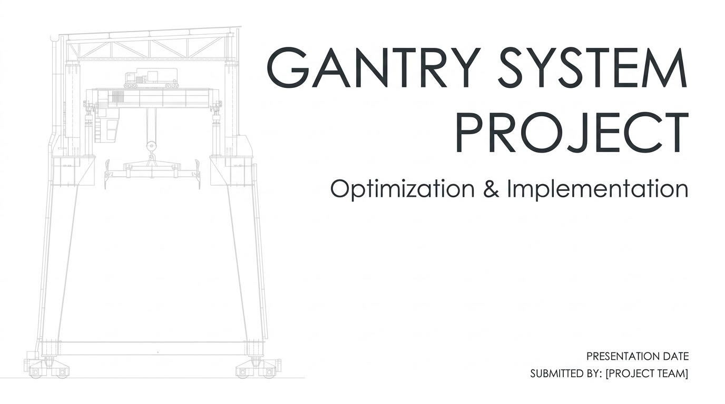
Submitted by: Gantry Project Team [Tex, Jael, Imprezz, Ricardo, Lance]
Notes:
Petition for asmr tex:
IP

Slide 2
Current Direction: Trouble in hobbyists paradise? Lifting Problems?
Our project is to build a suspended gantry system that can function in a variety of different workspaces, with adaptability through multiple different attachments that can be added on top of the current gantry system. This gives flexibility for manual user controls and additional automated functionality

Slide 3
What We’re Programming
Pathfinding
Simulation and virtual testing
Sensor communication and processing
User interfaces and communication
Diagnostics and safe shutdown
Software Integration

Slide 4
Pathfinding Algorithms
A* algorithm over Greedy best first and Dijkstra
Bresenham algorithm
S curve acceleration
Queued execution sequence
Queue -> A* -> Path Simplification -> Bresenham -> Motion

Slide 5
Questions?

Slide 6
